Slide 1
LOAN ELIGIBILITY PREDICTION USING ENSEMBLE LEARNING
Project Guide:
Mr. V Naveen kumar, M.Tech
Asst.Professor, Department of CSE
Presented by (Batch B11):
K.Lahari (Y20ACS484)
M.Sri Teja (Y20ACS507)
K.Kalyani (L21ACS412)
N.Hemanth (Y20ACS519)

Slide 2
Contents:
Abstract
Existing System
Proposed System
Design
Implementation
Results
Conclusion

Slide 3
ABSTRACT
Banks are making major part of profits through loans.
Loan approval is a very important process for banking organizations.
It is very difficult to predict the possibility of payment of loan by the customers because there is an increasing rate of loan default.
This is helpful to both bank staff and applicant. The time period for the sanction of loan will be drastically reduced.

Slide 4
EXISTING SYSTEM
Till now loans are processed by various banks through pen and paperwork.
When the large no of customer’s apply for bank loan these bank take lot of time to approve their loan.
After approval of loan by the banks,there is no surety that the chosen applicant is capable of paying loan or not.
Many banks use their own software’s for the loan approval.
In existing system datamining algorithms for the loan approval; this is the old technique for the approval of loan.

Slide 5
DISADVANTAGES
Checking details of all applicants consumes lot of time and efforts.
There is chances of human error may occur due checking all details manually .
There is possibility of assigning loan to ineligible applicant.
Less Efficiency.

Slide 6
PROPOSED SYSTEM
The proposed system automates the method of determining the applicants loan approval status.
We will train the machine with previous dataset.
So machine can analyse and understand the process.
Then machine will check for eligible applicant and give us result.

Slide 7
ADVANTAGES
The result obtained by the Random Forest is best compared to any other Algorithms.
Time period for loan sanctioning will be reduced.
Whole process will be automated, so human error will be avoided.
Eligible applicant will be sanctioned loan without any delay.

Slide 8
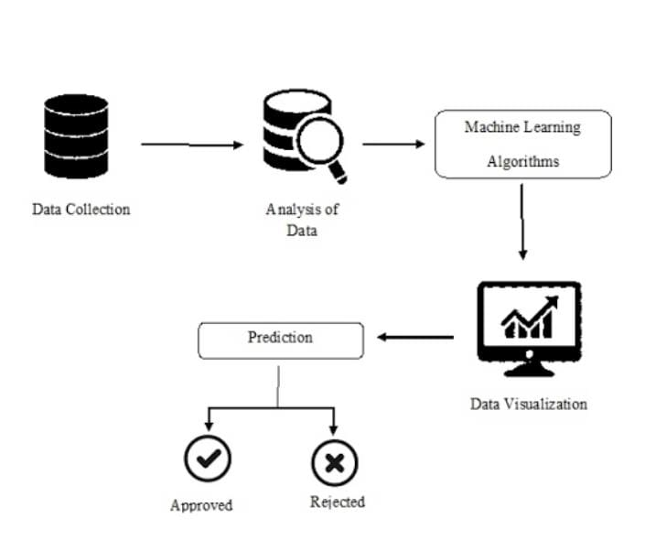
DESIGN

Slide 9
iMPLEMENTATION
Importing all the necessary libraries
Preprocessing
Defining Machine Learning Algorithms
Training and Evaluation
Testing the Model
Integrating with Web Application using Django

Slide 10
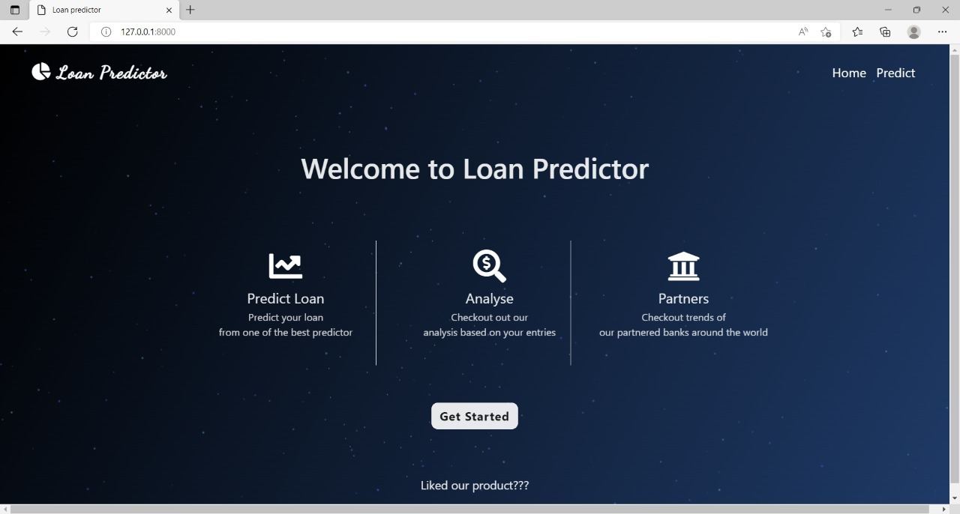
RESULTS

Slide 11
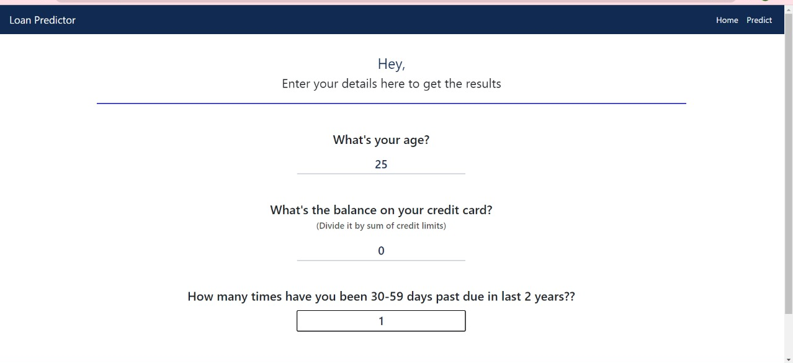
RESULTS

Slide 12
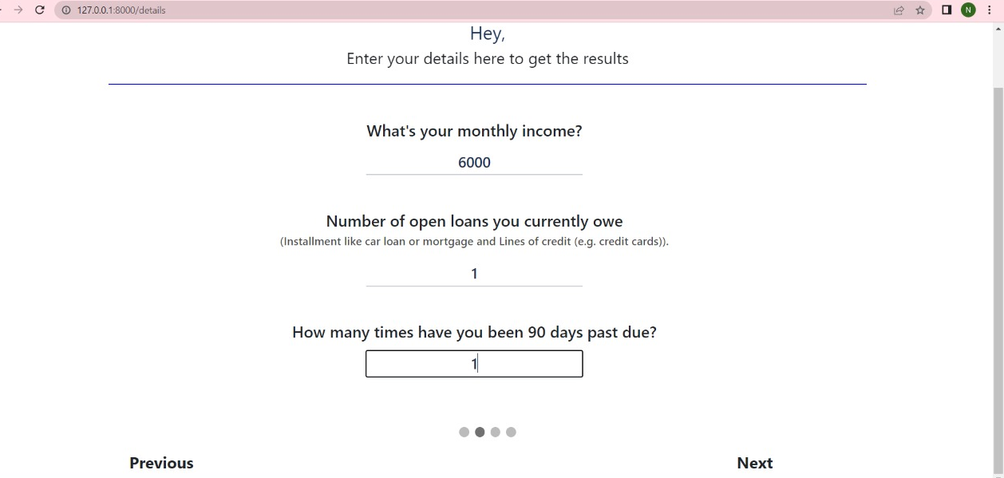
RESULTS

Slide 13
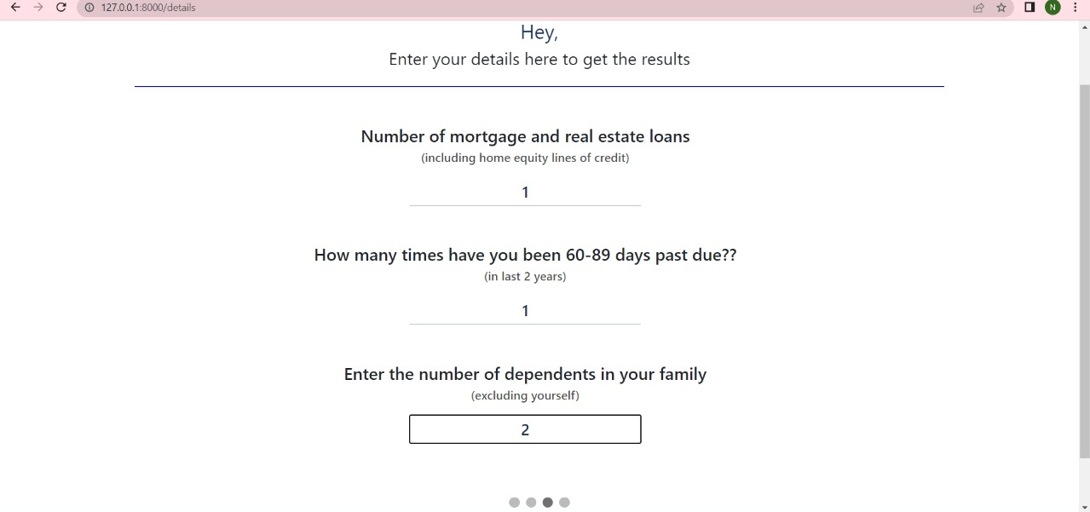
RESULTS

Slide 14
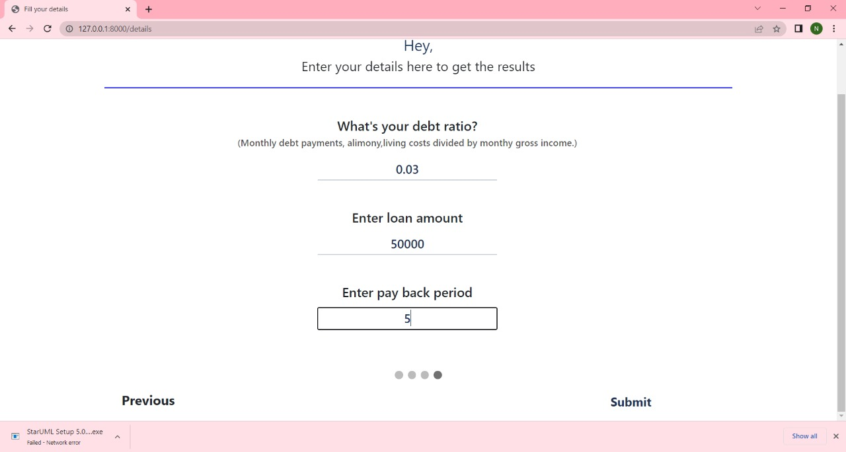
RESULTS

Slide 15
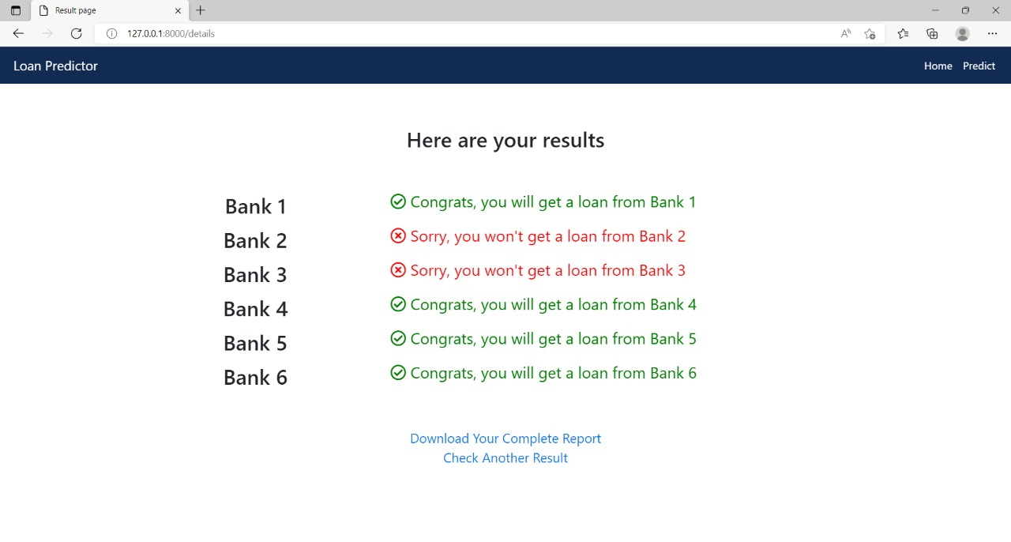
RESULTS

Slide 16
CONCLUSION
A Loan Prediction System that helps the banks and making the right decision to approve or reject the loan request of the customer .
The choice of algorithm plays a crucial role in loan decision management, as this helps determine the likelihood of loan default by clients.

Slide 17


